Slide 1
VOICE RECOGNITION BASED EMAIL USING SMTP AND IMAP SERVERS
BY
A.ABDUL ATHIF (312420104003)
A.ASHOKMITHRA (312420104016)

Slide 2
TABLE OF CONTENTS
Introduction.
Motivation.
Objectives.
Literature Survey.
System Architecture.
Module Explanation.
Results.
Conclusion.
Future Work.
References.

Slide 3
Introduction
E-mails are the most dependable way of communication over Internet, for sending and receiving some important information. Many people find it difficult to manage their emails on a daily basis. Typing out emails on a mobile device can be time-consuming and tedious, they are also challenging for the visually impaired persons. This system aims at developing an email system that will help even a visually impaired person to use the services for communication without previous training. The system is completely built on interactive voice response which will make it user-friendly and efficient to use.

Slide 4
MOTIVATION
A voice-based E-mail system design that allows a blind person to simply and efficiently access E-mails.
Also the voice-based email project aims to make email communication more accessible and convenient for users who have limited typing abilities or who prefer to use voice commands. The project utilizes speech recognition technology to allow users to dictate and send emails using their voice, making it an innovative to use the application in a more effective manner.

Slide 5
OBJECTIVES
The major objectives of the Voice Recognition Email using SMTP and IMAP servers are:
Increasing efficiency.
Improving accessibility.
Enhancing convenience.
Facilitating better Communication.
Reducing errors.

Slide 6
LITERATURE SURVEY:
[1] Tirthankar Dasgupta, “Voice Mail Architecture in Desktop and Mobile Devices for the Blind People”, 2012. The advancement in computer based accessible systems has opened up many avenues for the visually impaired across a wide majority of the globe. Audio feedback based virtual environment like, the screen readers have helped Blind people to access internet applications immensely. However, a large section of visually impaired people in different countries in particular, the Indian sub-continent could not benefit much from such systems. In this paper, we describe the Voice Mail system architecture that can be used by a Blind person to access e-Mails easily and efficiently.

Slide 7
LITERATURE SURVEY:
[2] Ummuhanysifa U., “Voice Based Search Engine and Web Page Reader”, 2013. This paper aims to develop a search engine which supports Man-Machine interaction purely in the form of voice. A novel Voice based Search Engine and Web-page Reader which allows the users to command and control the web browser through their voice, is introduced. The existing Search Engines get request from the user in the form of text and respond by retrieving the relevant documents from the server and displays in the form of text.

Slide 8
LITERATURE SURVEY:
[3] Tharani K. K., “Voice Based Mail Attachment For Visually Challenged People”, 2017. Internet has become one of the basic amenities for day-to-day living. Every human being is widely accessing the knowledge and information through internet. However, blind people face difficulties in accessing these text materials, also in using any service provided through internet. The advancement in computer based accessible systems has opened up many avenues for the visually impaired across the globe in a wide way.

Slide 9
LITERATURE SURVEY:
[4] D. Kiran Kumar, “User Interface for Visually Impaired People” The research work deals with the design and implementation of Speech recognition device using Raspberry Pi for essential usage to visually impaired people. Now a day’s blind people are increasing enormously so, the main objective of the research is to provide a simple, cheap, friendly user, and compact device for visually impaired people to use multimedia applications of operating system like text, music player and dialing system by interfacing GSM module. All the above are implemented in a low cost Raspberry Pi board. Thus a goal of producing a compact device has been designed at low cost using offline speech recognition.

Slide 10
LITERATURE SURVEY:
[5] “Voice Based System in Desktop and Mobile Devices for Blind People”, 2014. Today in the information age computer has become an integral part of every body’s life. We use a computer to hear songs, read something, accessing information from the internet. We use computer everywhere. But the information access and computer handling has to be done with the mouse and keyboard and by reading all the things present on the screen and then deciding what to do making it a visual process means we need eye sight to handle the information on the computer i.e. if we want to read news from the internet we have to first open a browser and then open a website to read news and then follow the links to read specific news

Slide 11
LITERATURE SURVEY:
[6] Anushka Dixit et al., proposed an application which accepts voice command as input and with the help of voice to text converter, the speech is converted to a command to the application. Based on the command, the corresponding action will be performed. The output is converted from text to audio as speech through the text to speech convertor. This application has 3 modules which are Inbox, Sent mail and, Trash. Inbox contains all received mails. Sent mail is to compose a mail through which speech is converted to text. Trash is to keep a track of all deleted mails.

Slide 12
LITERATURE SURVEY:
[7] Taslima Binte Hossaina et al., proposed a voice mail android application, which is used to send email through voice. This application has several processing steps which involve processing the voice using API, converting to text, processing the text using API, converting to voice and connecting to the server using Gmail API. This application uses a set of Google API for text to speech and speech to text conversion.

Slide 13
LITERATURE SURVEY:
[8] Milan Badigar et al., proposed and designed an android application, which process the voice to text and vice versa to send, read, forward and reply email. This system uses the user fingerprint to authenticate the user. Java Mail application platform is used to build mail and messaging applications. Navigation commands like compose, receive emails, sent mails and go back are used to perform certain actions. Database is stored in SQLite software library which is provided by Android.

Slide 14
LITERATURE SURVEY:
[9] “Voice Based System in Desktop for Blind People". Voice message engineering encourages blind individuals to get to email and other interactive media elements of working framework. Additionally, in mobile application SMS can be perused by framework itself. Presently the headway made in PC innovation opened stages for visually defective individuals over the world. It has been seen that almost about 60% of absolute visually impaired populace over the world is available in INDIA. Here authors depict the voice message design utilized by blind individuals to get to E-mail and media elements of working framework effectively and productively. This design will likewise decrease intellectual burden taken by oblivious in regards to recall and type characters utilizing console

Slide 15
LITERATURE SURVEY:
[10] “Voice-based email for visually impaired people: A usability study" by F. Di Tore, S. Sorce, and R. Lanzilotti (2016) - This study investigates the usability of voice-based email for visually impaired users and compares it to traditional email interfaces. The authors found that voice-based email was preferred by most participants and was more efficient than traditional email for some tasks.

Slide 16
LITERATURE SURVEY:
[11]"Towards hands-free email composition: a study of speech-based and gesture-based interaction" by M. Hausenblas, S. M. Böhlen, and M. Tscheligi (2013) - This paper presents a study on speech-based and gesture-based interaction for email composition, with the goal of creating a hands-free email system. The authors found that speech-based interaction was more efficient and faster than gesture-based interaction.

Slide 17
LITERATURE SURVEY:
[12] "A comparative study of speech-based and text-based email interfaces" by M. McTear, A. Nixon, and L. Panek (2002) - This study compares speech-based and text-based email interfaces and evaluates their effectiveness for users. The authors found that speech-based email was preferred by some users and was more efficient for certain tasks.

Slide 18
LITERATURE SURVEY:
[13] "Voice user interface design for email applications" by M. Park and S. Lee (2018) - This paper presents a framework for designing voice user interfaces for email applications. The authors highlight the importance of considering user needs, such as reducing cognitive load and improving task efficiency, when designing voice-based email interfaces.

Slide 19
LITERATURE SURVEY:
[14] "Voice-based email as an assistive technology: A case study of blind users in India" by A. Kumar and A. Ghosh (2014) - This paper explores the use of voice-based email as an assistive technology for blind users in India. The authors found that voice-based email was a useful tool for communication and had the potential to improve the quality of life for blind users.

Slide 20
LITERATURE SURVEY:
[15] Voice-Based E-Mail System using Artificial Intelligence Rijwan Khan, Pawan Kumar Sharma, Sumit Raj, Sushil Kr. Verma, Sparsh Katiyar: One of the most used forms of communication among people is Email. A lot of confidential and urgent information is exchanged over emails in today’s time. There are about 253 million visually impaired people worldwide. These visually impaired people are facing a problem with communication. Since technology is growing day by day these types of visually challenged people feel that they are more challenged. So, the authors proposed a Voice-based Email System using AI that will make the email system very easily accessible to visually challenged people and also help society. Accessibility is the most important feature that is considered while developing this system. Any system is called accessible only if both able and disabled people can use it easily.

Slide 21
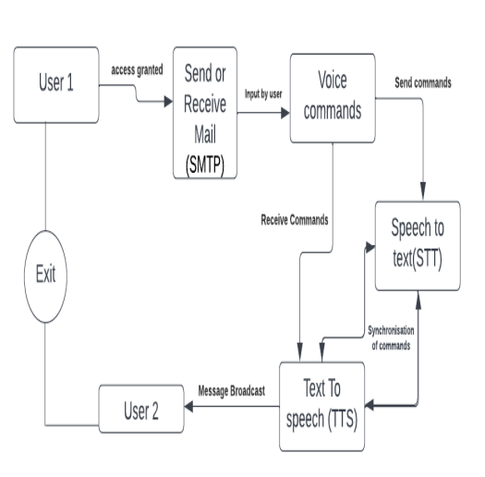
OVERALL SYSTEM ARCHITECTURE

Slide 22
EXPLANATION OF VARIOUS MODULES USED
The various modules used in our project are:
voic.py
information.py
talk.py
send_email.py

Slide 23
Voic.py
The voic.py file is a Python script that provides functions for checking an email inbox using IMAP protocol. Specifically,it allows you to check for unseen emails in inbox and retrieve their details. To accomplish this, the script of uses the built-in imaplib module in Python, which provides an easy-to-use interface for interacting with an IMAP server. It establishes a connection to server, logs in with your credentials,and selects inbox folder to perform the search. The retrieved email data is then printed tothe console, allowing you to see the details of any of unseen emails in your inbox.

Slide 24
Information.py
The information.py file is a Python script that utilizes the Speech Recognition library to perform voice recognition. Specifically, it listens to the user's spoken input and uses Google's speech recognition API to convert it to text. The script can be used to perform a variety of tasks, such as searching the web or retrieving information from a database, based on the user's spoken.

Slide 25
Talk.py
The talk.py file is a Python script that uses the pyttsx3 library to convert text to speech. It initializes a text-to-speech engine using pyttsx3.init() and defines a talk() function that accepts a text input, converts it to speech using the engine's say() method, and then plays the audio using engine.runAndWait(). This script can be useful in applications that require voice prompts or audio feedback, such as virtual assistants or interactive systems.

Slide 26
SEND_EMAIL.PY
The send_email function in this Python script uses the built-in smtplib library to send an email message through a Gmail account. It takes three arguments as inputs: the email address of the recipient (receiver), the subject line of the email (subject), and the content of the email message (message).
This script can be useful for automating the process of sending email messages through a Gmail account, and could be integrated into larger projects or used on its own to simplify email communication. Note that in order to use this script, you will need to replace the email and password values with your own valid Gmail credentials.

Slide 27
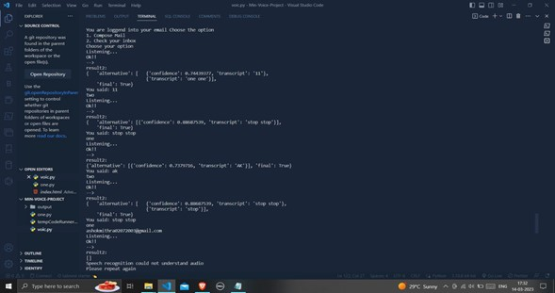
RESULTS

Slide 28
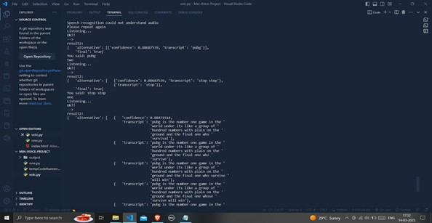
RESULTS

Slide 29
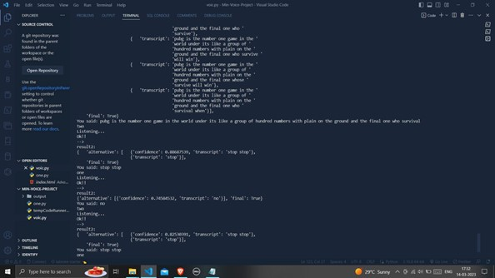
RESULTS

Slide 30
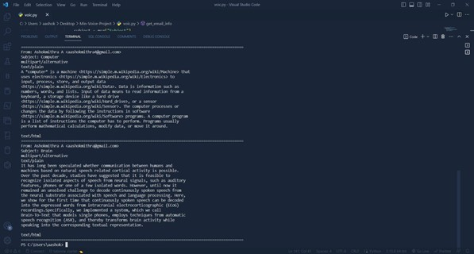
RESULTS

Slide 31
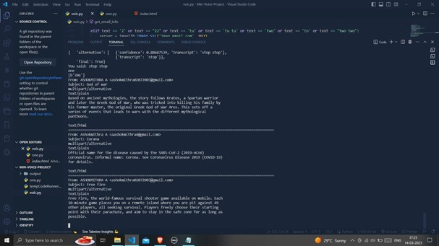
RESULTS

Slide 32
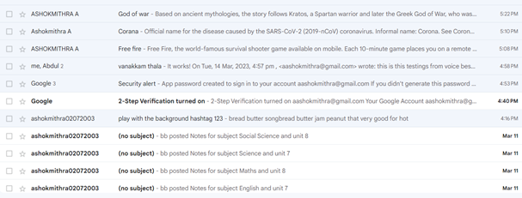
RESULTS

Slide 33
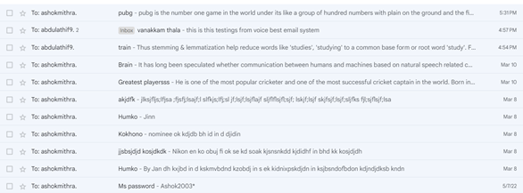
RESULTS

Slide 34
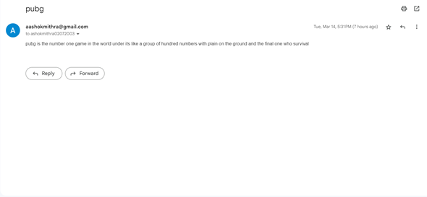
RESULTS

Slide 35
CONCLUSION
This project is the best applicable for physically challenged people and the one who has typing disabilities. The system is based on IVR voices and there is no use of keywords. Any users are able to use the system as it does not require any prior knowledge. The system is quite efficient and accessible to utilize for the communication for the blind people and persons loving voice based applications. There is no need to write or type the messages in the inbox of the email only through your voice’s communication is possible. It enhances the path of communication in a fast and interesting way. This e-mail system can be used by any user of any age group with ease of access. It has the feature of speech to text as well as text to speech with speech reader which makes designed a system to be handled by a visually impaired person.

Slide 36
FUTURE WORK
There can be wide scope of the system with its functionalities. It can consist of options for reading deleted and spam emails. The system will be more in demand if it will be accessible in all the regional languages. It will promote interaction at a higher level as it will require nothing special to use the system. It can be designed in more advanced ways by adding options of voice call and short messaging services (SMS). Further adding the proposed functionalities will take it to the global market and also will give facilities to communicate with each other in different ways.

Slide 37
REFERENCE
[1] Conferencing, Paging, Voice Mailing via Asterisk PBX – Ale Imran and Mohammed A. Qadeer [2019]
[2] Finding with the design of a command- based speech interface for a voice mail system -S,Gamm and D.Langmann [2018]
[3] Design and implementation of voice mail in IP telephony based on Mediastreamer2- Xu Yue and Xu Bing[2021]

Slide 38
REFERENCE
[4] On the integration of MPEG-4 video streams with voice and email data packet traffic over wireless picocell networks- P. Koutsakis, S. Psychic and M. Paterakis[2001]
[5] Performance analysis of Voice message service in CDMA cellular systems”- Song Liu, Zhisheng Niu and Dawei Huang [2020]
[6] The design and implementation of Voice mailbox system based on VoIP- Jingyang Wang, Peng Ren and Min Huang[2015]

Slide 39
REFERENCE
[7] Multi-channel adaptive algorithm for acoustic noise suppression of DFT method in systems voice messaging- Y.A Kropotov [2012]
[8]A Voice Communication-Augmented Simulation Framework For Aircraft Trajectory Simulation- Yuhao Wang, Michael Thomas and Yutian Pang[2021]
[9] Transfer Learning From Speech Synthesis to Voice Conversion with Non-Parallel Training Data- Mingyang Zhang, Yi Zhou and Li Zhao [2021]

Slide 40
REFERENCE
[10] Email classification via intention based SegmentationSanjay Kumar Sonbhadra, Sonali Agarwal and Krishna Adiyarta [2020]
[11] Discovery of Activities Actor Perspective from Emails based on Speech Acts Detection- Marwa Elleuch, Nassim Laga, Walid Gaaloul and Oumaima Alaoui Ismaili [2020]
[12] Human computer interaction(HCI) based Smart Voice Email Application – Assistant for Visually Impaired users (VIU)- Sheryl Noel [2020]

